Slide 1
Guidelines For OCP Tech Sub-Team GitHub Organizations
Anthony Franklin
Lauren Tran

Slide 2
Agenda
Big Picture & Vision
OCP Tech Sub-Team GitHub Orgs & Details
What's Next

Slide 3
Big Picture
Tech Intensity initiative (OCP Flavor)
Tech Assets Categorization:
Tier 1 = US OCP Published – available (internally or externally) for re-use
Tier 2 = US OCP Managed – managed by governance to scale impact & re-purposing
Tier 3 = US OCP Strategic – funded, partner-prioritized, proven measured success (I.e. ACR)
MSUS OCP Technical Governance Guidance (FY21)

Slide 4
Vision
Upskill OCP Tech Team members on GitHub
Each OCP Tech Sub-Team with a GitHub organization for partner focused assets.
The collective Sub-Team orgs roll-up within the OCP Governance Board Framework.

Slide 5
OCP Tech Sub-Team GitHub Orgs

Slide 6
What?
This is a centralized repository for Tier 1 reusable/technical assets, solutions, and content aimed to serve US OCP Tech Team partners within a corresponding sub-team discipline.

Slide 7


US OCP Sub-Team Org for Partner Asset Repos
OCP Member 1
Repo
MSUS OCP Sub-Team Org
www.github.com/{sub-team}
Reverse Fork
Partner 1
OCP Member 2
Repo
Partner 2
Partner K
Public Access
OCP Member X
Repo
Microsoft OCP Sub-Team
Partner Community

Slide 8
Why?
OCP Tech Sub-Teams are tasked with curating, developing and sharing reusable content to enhance and support the Azure partner community.
A centralized collection of assets provides the following benefits:
Discoverable assets
Simplified sharing
Simplified maintenance
Asset monitoring
Asset preservation
Industry accepted

Slide 9
How?
Reverse Forking
Fork an existing repo into the OCP sub-team org.
Content Sharing
Upload, store, or templatize individual assets intended for partner consumption.
Original Repo
Create an original repo within the GitHub project to support team collaboration.

Slide 10
The Setup
Appoint OCP sub-team member(s) as project leads
A project lead to create a GitHub organization
Naming convention:
<country>-ocp-<sub-team>, i.e. “us-ocp-ai”
How to Create a GitHub Organization
Create a main project repo within organization and upload the following README template:
Template to Customize
Example: us-ocp-ai main repo
Invite other OCP sub-team members as owners
Create a "Presentable Assets" repo
Example OCP Tech Sub-Team Org
https://github.com/us-ocp-ai

Slide 11
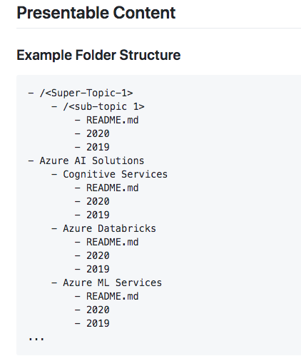
Presentable Content
Folder Structure
Super-Topic
Sub-topic
Year
Year-1

Slide 12
Tier 1 Asset Guidelines & Checklist
Tags
Tag == <Sub-Topic>
License
Readme
Description
Repo naming conventions
Use lower cases
Use dashes
Avoid camel casing
Be specific, descriptive, brief
e.g. predictive-maintenance

Slide 13
Use Cases
Partner requested code-based assets
Partner requested presentable assets
OCP Tech Sub-Team led partner workshops
Partner Asset development tracking

Slide 14
Next Steps
P20 session (20 min)
Focus to upskill our tech team with Git and GitHub fundamentals
Marketing for WhatTheHack "Intro to GitHub"
Team specific centralized repo of partner assets (best practices)
WhatTheHack (Intro to GitHub)
1 day hack (2 options)
Most common Git and GitHub operations

